Slide 1




Ontology Registries:
current developments and opportunities
María Poveda-Villalón, Ontology Engineering Group
Universidad Politécnica de Madrid, Spain
mpoveda@fi.upm.es
MariaPovedaV
17/10/2023
SEMIC, Madrid
Notes:
Cambiar la licencia por la que aplique.

Slide 2


(https://www.w3.org/standards/semanticweb/ontology)
A vocabulary defines the concepts and relations used to describe and represent a domain of interest

Slide 3
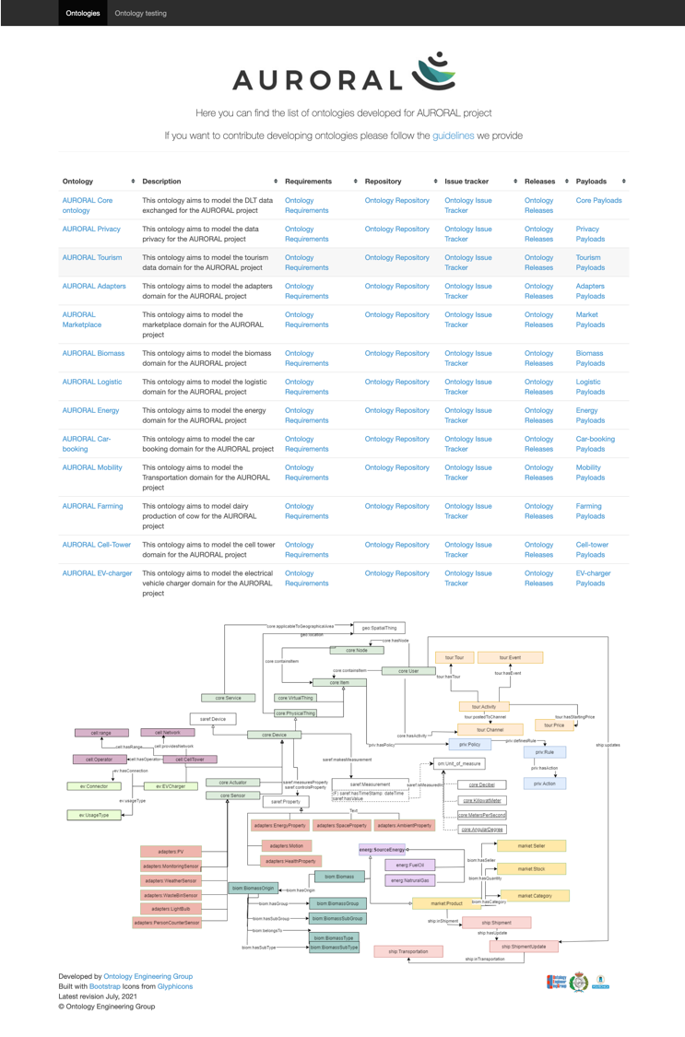




Why
Increase interoperability
Reduce development time & resources
Within organizations (e.g. OEG)
Specific portals per project, organization

Slide 4
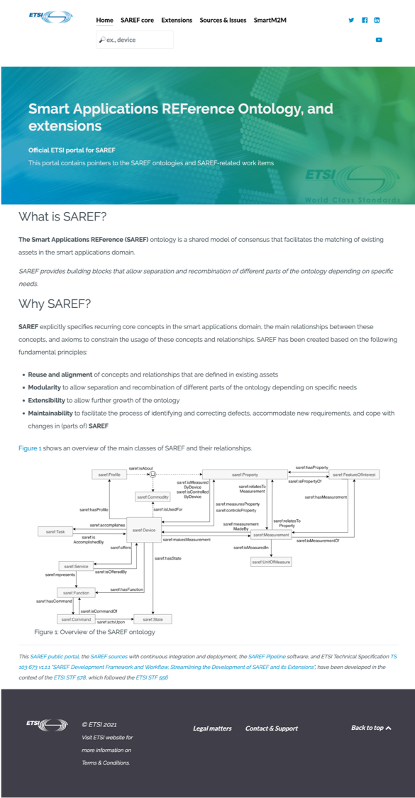

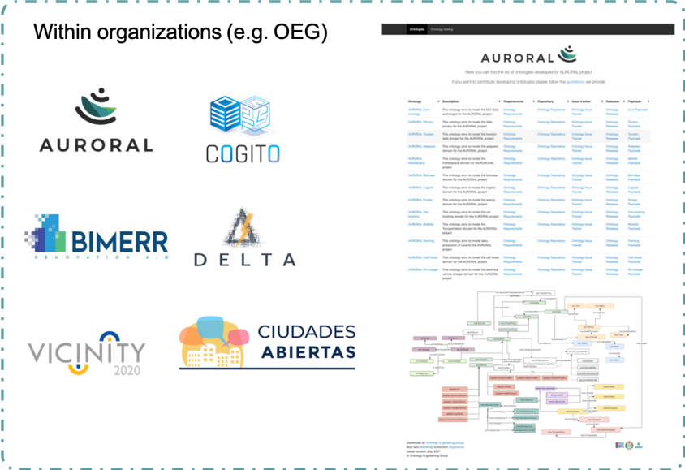
Why
Increase interoperability
Reduce development time & resources
Within standardization bodies

Slide 5
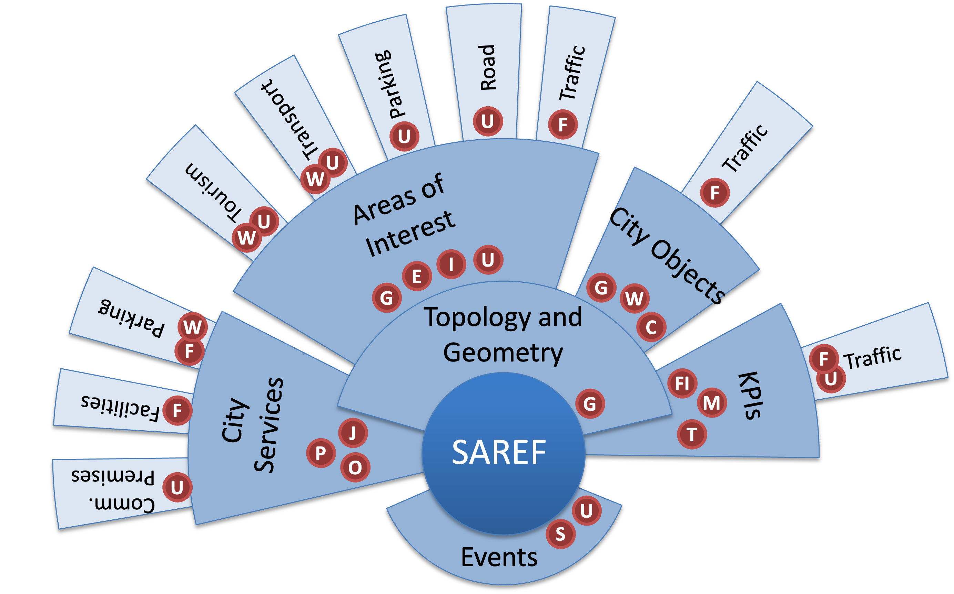

Why
Requirements:
EU Metadata Registry
FEMP Open Data Guide exemplary datasets
FIWARE data model for KPIs
ISA Programme Location Core Vocabulary
Joinup Core Public Organization Vocabulary
Joinup Core Public Service Vocabulary
OGC CityGML
OGC GeoSPARQL
schema.org
Vocabulary referenced by AENOR UNE 178301:2015
W3C Registered Organization Vocabulary
W3C WGS84 Geo Positioning vocabulary
ISO/IEC 30182:2017
ITU-T Y.4903/L.1603 (10/2016)
E
SAREF4CITY
F
FI
I
J
P
C
G
S
U
O
W
M
T

Slide 6
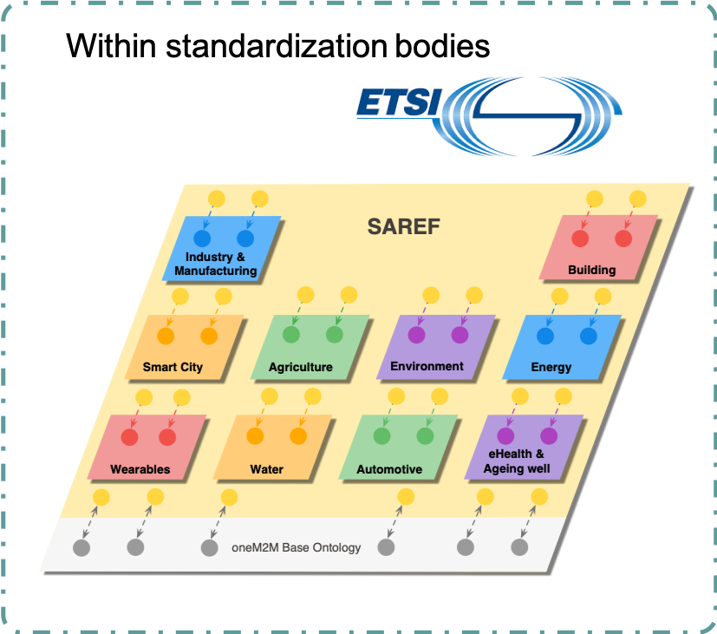
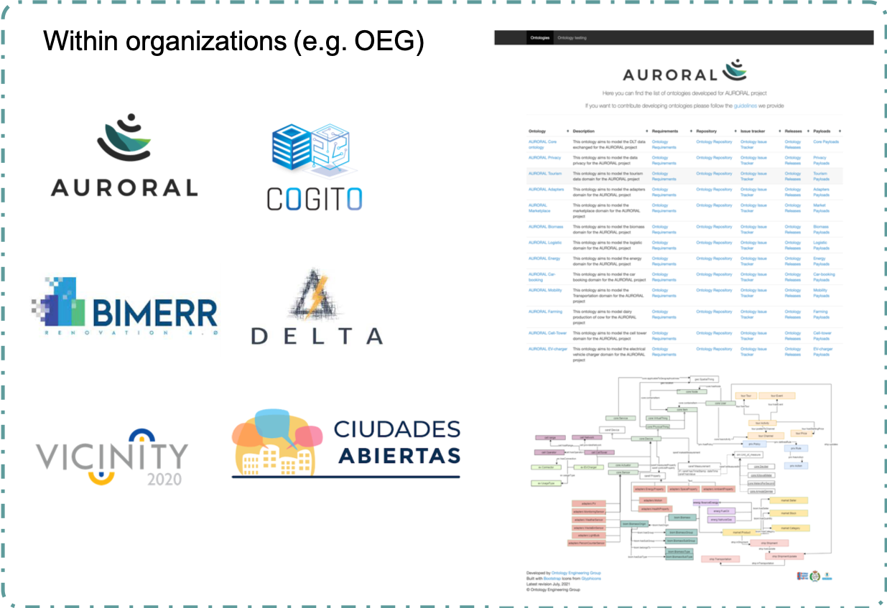
Why
Increase interoperability
Reduce development time & resources
Within community efforts / Open Calls
Open Calls

Slide 7
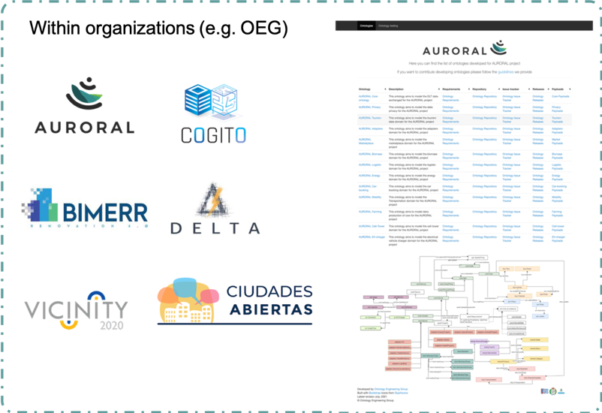
Why
Increase interoperability
Reduce development time & resources
Regional / National / European initiatives
Organizations
IoT
Publications
Assets
Legal
Public Service
Person
Geographical
Location
Code lists
Time

Slide 8


Current Technologies - Linked Open Vocabularies
Mission: promote and facilitate the reuse of well documented vocabularies in the Linked Data ecosystem
Vocabularies registry and index
http://lov.linkeddata.es/
Datalift (original project)
http://datalift.org/
Started at 2011
Hosted by OEG
Notes:
Th
Almost 600 vocabs since 2011

Slide 9
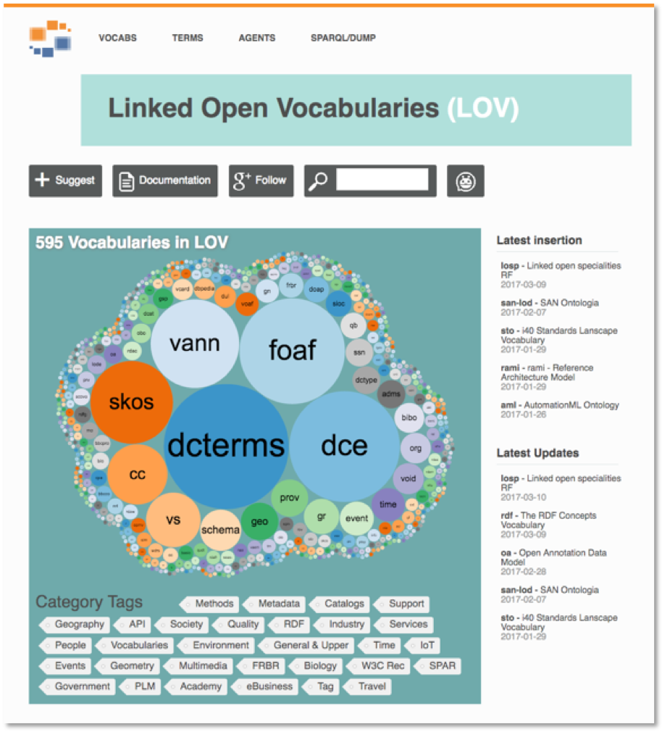
Features - Vocabs

Slide 10

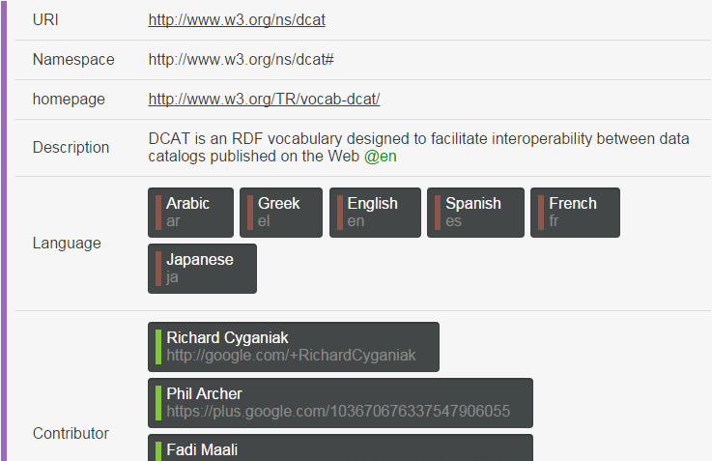
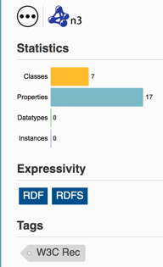
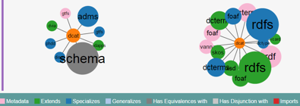
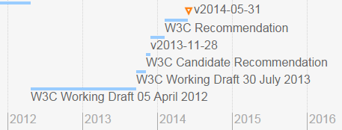
Information about vocabularies
Connection with other applications
Metadata
Relationships
Versions
Notes:
First basic feature is to provide main information about vabularies. Descripción title, authors, language... Together with some statisticss and associated tags, used previously to clategorize the vocabs. Explain the different types of relationships. Reference to VOAF vocabulary

Slide 11
Features – Terms

Slide 12
Search terms
Ranked
Term appearing in primary and secondary annotations
Vocabulary popularity in LOV
Term use in LOD
Filters

Slide 13
Features – Provide data

Slide 14
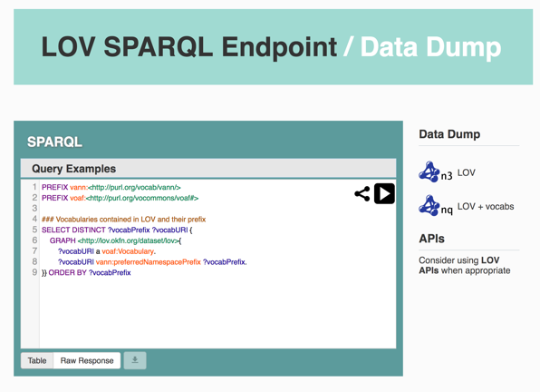
Data & API
Dumps
SPARQL query

Slide 15
Features – Suggest vocabs

Slide 16
Suggestions & Quality checking
LOV curation team
LOV curation team
Metadata: title, description, authors, dates, vann, version, etc.
Human readable: labels and comments
Publication
Licence
Authors
Notes:
Anyone can suggest a vocabulary to be included in LOV. For authors there is a recommendation guide provided in which basic metadata and good practices are described. Once the vocabulary is submitted the curation team gets in LOV back office system. It automatically autofill many fields extracting the metadata from the ontology code, however they should be manually approved and some fields needs manually edition. If the vocabulary does not meed the minimal requirements, we start a conversation by email with authors. It is important then to state authors and contributions in the vocabulary code so that we know

Slide 17
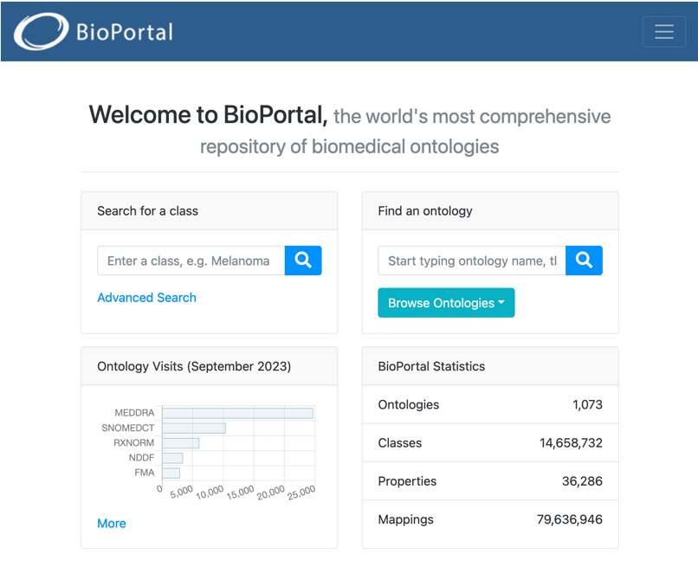

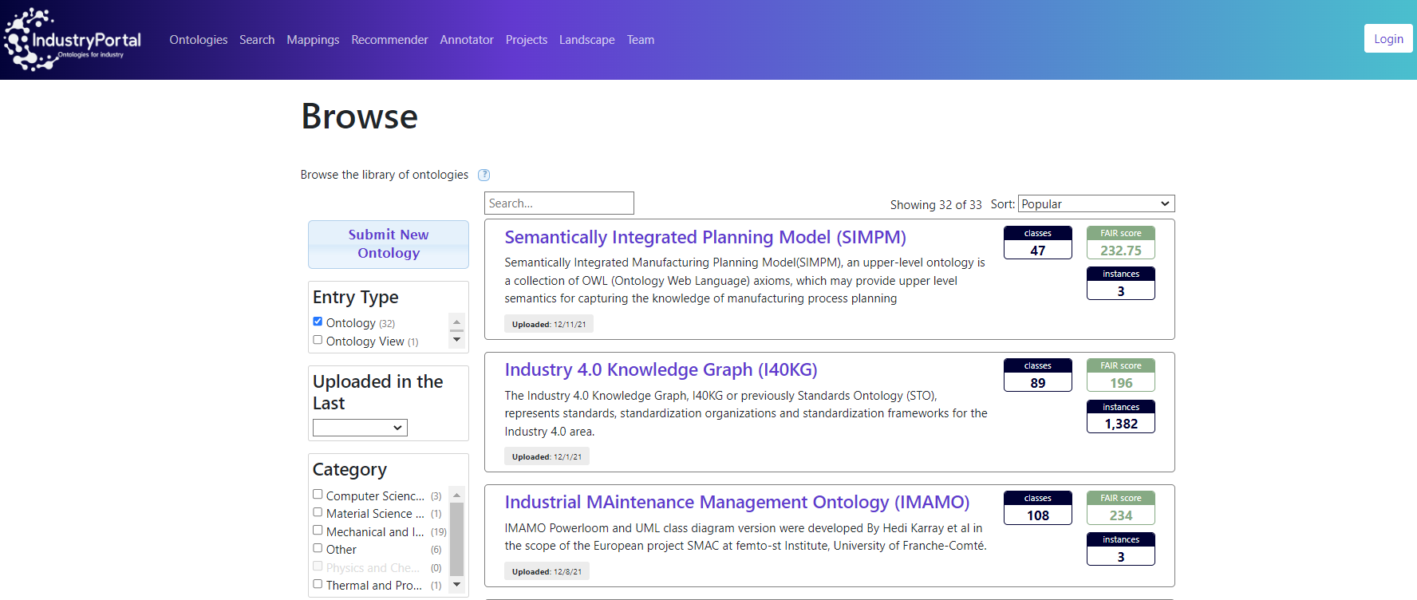


Other registries

Slide 18




Current and future work
Sustain
Federated services
To ease transfer of knowledge
Co-evolve
Ontology parliament
Ontology reuse support
Combination
Co-create
https://chowlk.linkeddata.es/
Understandability
Work together
Meet together
Governance
FAIR principles for Semantic Artefacts
Minimum metadata & recommendations
Best practices for vocabulary publishing
FAIR by design methodology
API &metadata aligments
Slide adapted from
Raúl García-Castro
https://w3id.org/foops/
18

Slide 19

Thanks!
Acknowledgments: Raúl García-Castro
Image by tartila / Freepik

